Slide 1
Case Study RoadReady – Car Rental System
Trainee name : Tharun.D
Trainer name : Mr. Javeed Mohammed Husnuddin

Slide 2
Case Study Summary
I developed a Car Rental System where users can book, manage, and pay for car rentals. The project has three main backend services made using Java, Spring Boot, and MySQL.
User Service - handles user registration, login, roles, and feedback.
Vehicle Service - manages car details, availability, and filtering.
Rental Service - takes care of reservations, payments, and reports.
The frontend is made with Angular and styled using Bootstrap. I used JWT tokens for secure login. Everything is connected and runs smoothly using Docker and Docker Compose.

Slide 3
Models used
1. UserInfo - Represents a user in the system (admin, customer, or agent).
2. Car - Represents a car available for rental.
3. Reservation - Represents a car booking made by a user.
4. Payment - Stores payment details for a reservation.
5. Feedback - Stores feedback or complaints submitted by users.

Slide 4
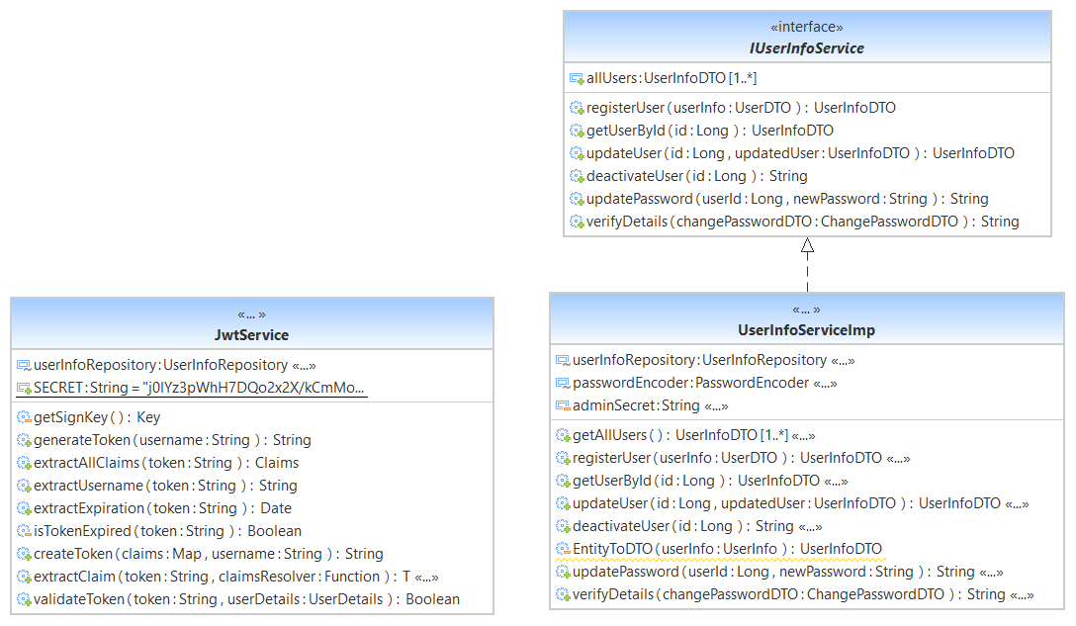
User Service Class Diagram

Slide 5
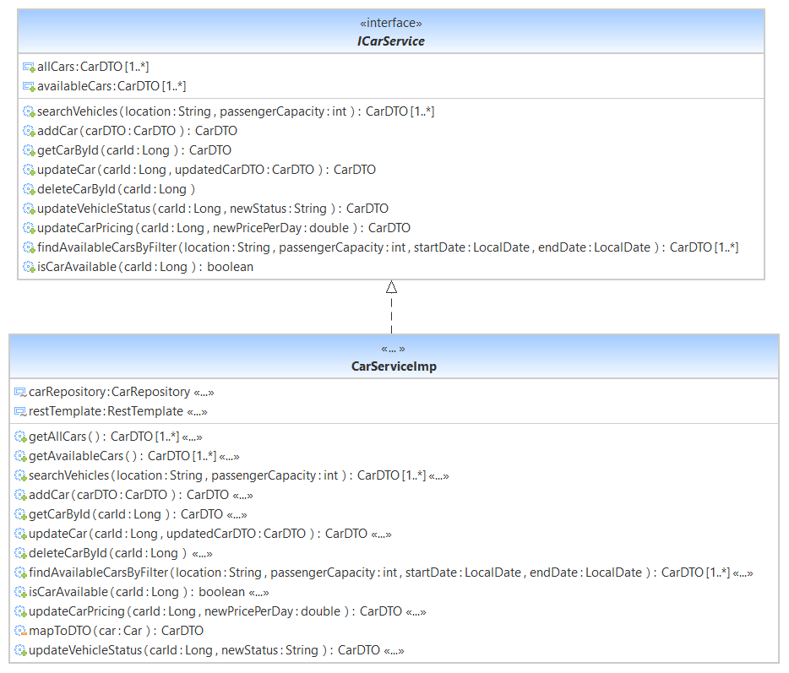
Car Service Class Diagram

Slide 6
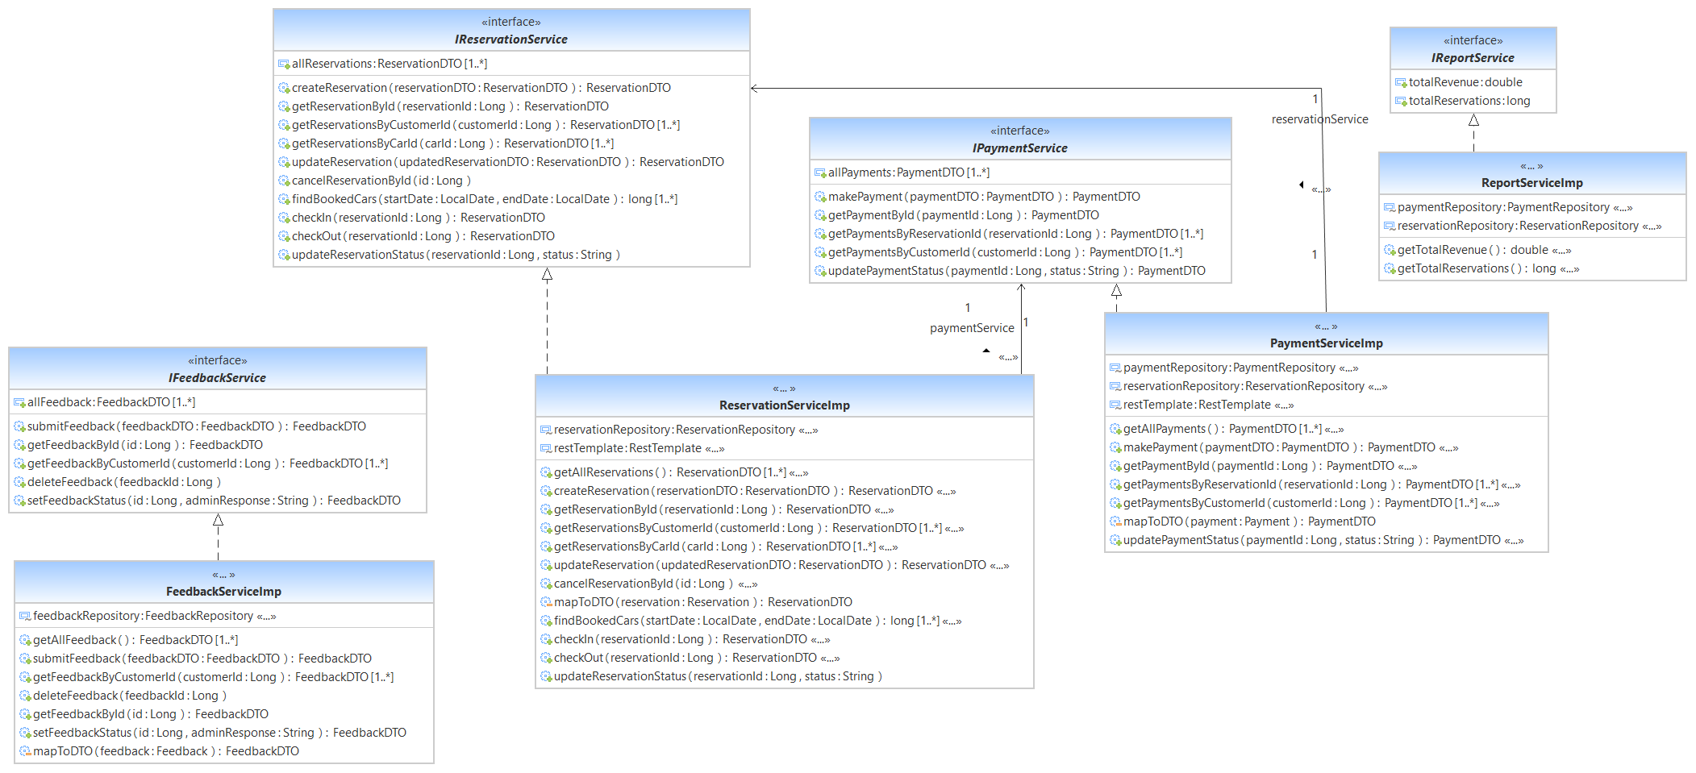
Rental Service Class Diagram

Slide 7
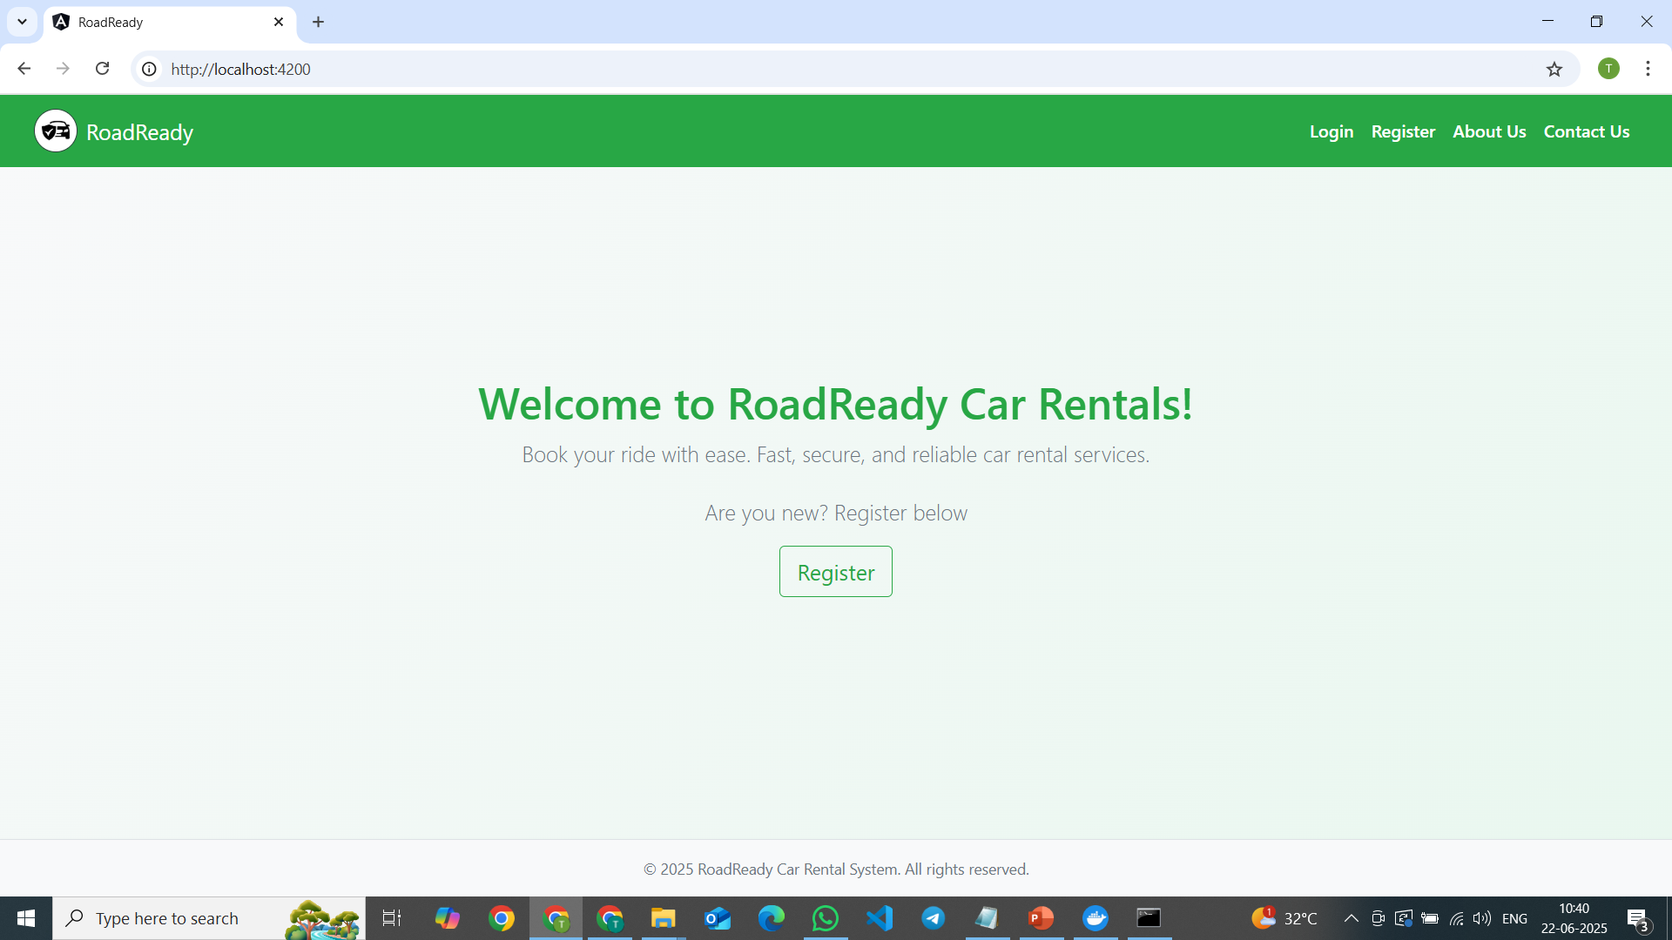
Landing page

Slide 8
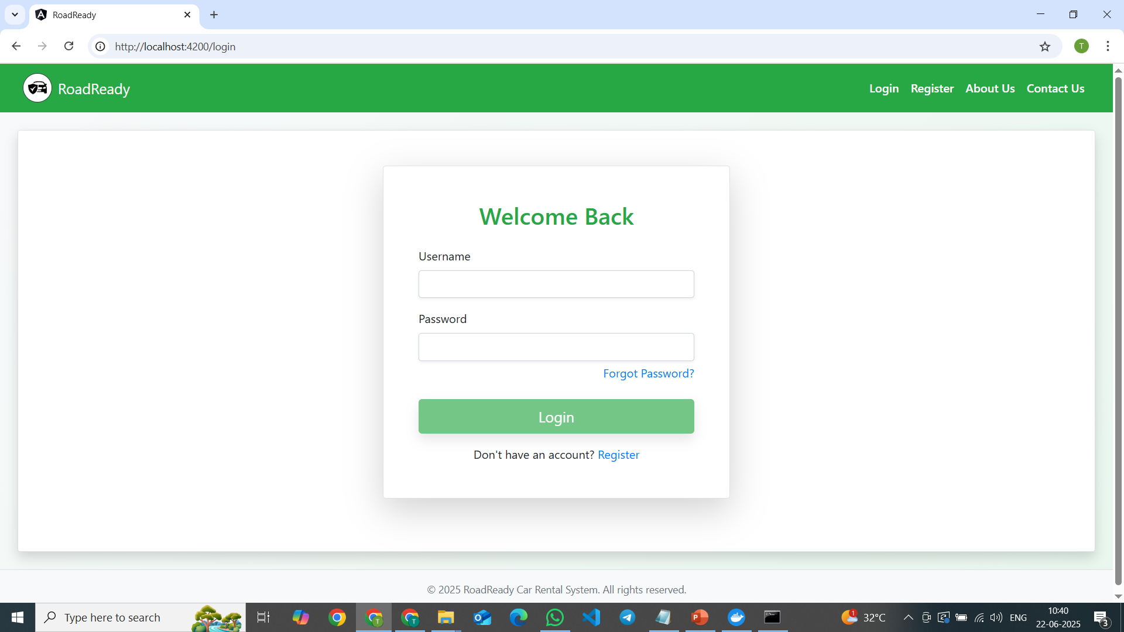
Login page

Slide 9
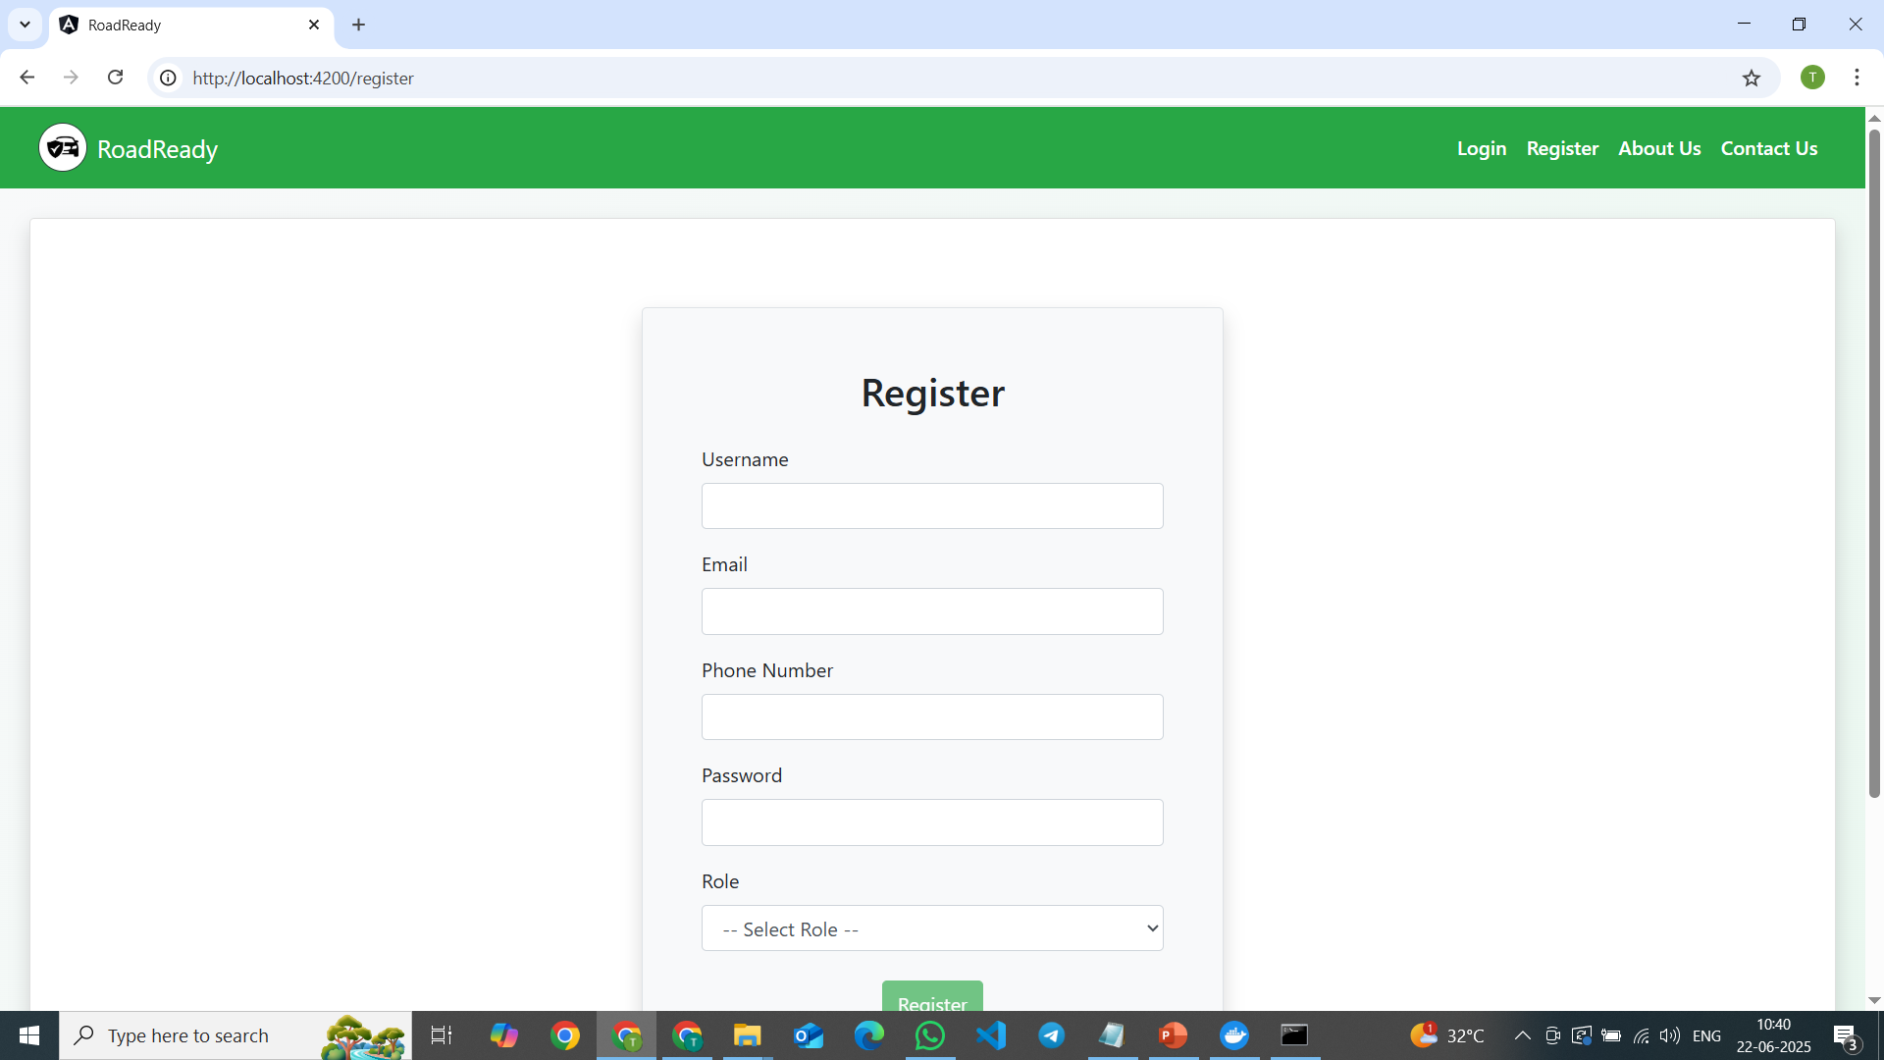
Register page

Slide 10
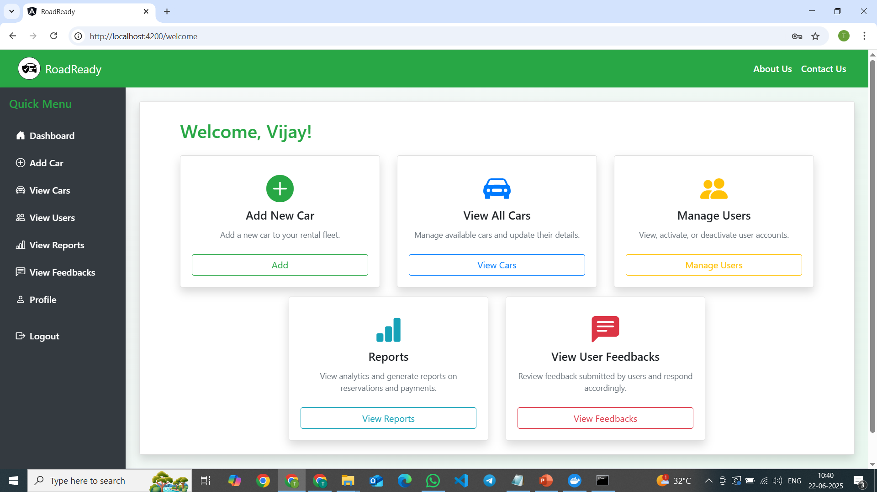
Admin Dashboard

Slide 11
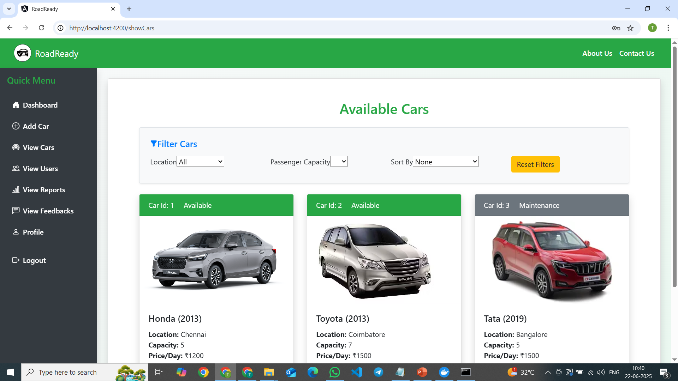
View cars

Slide 12
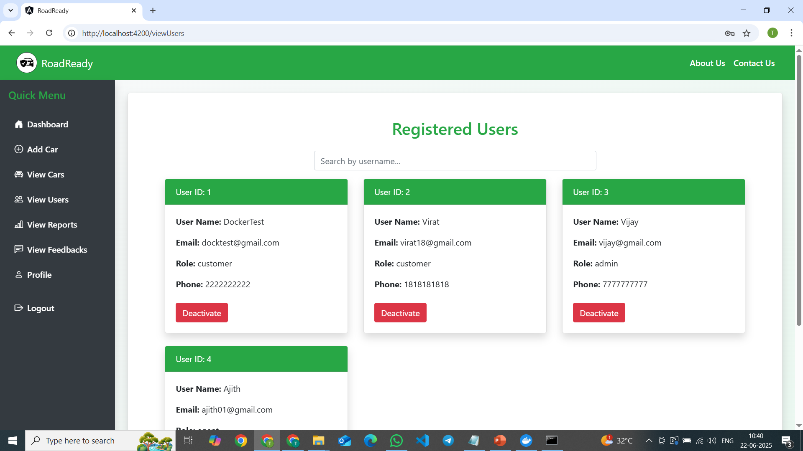
View users

Slide 13
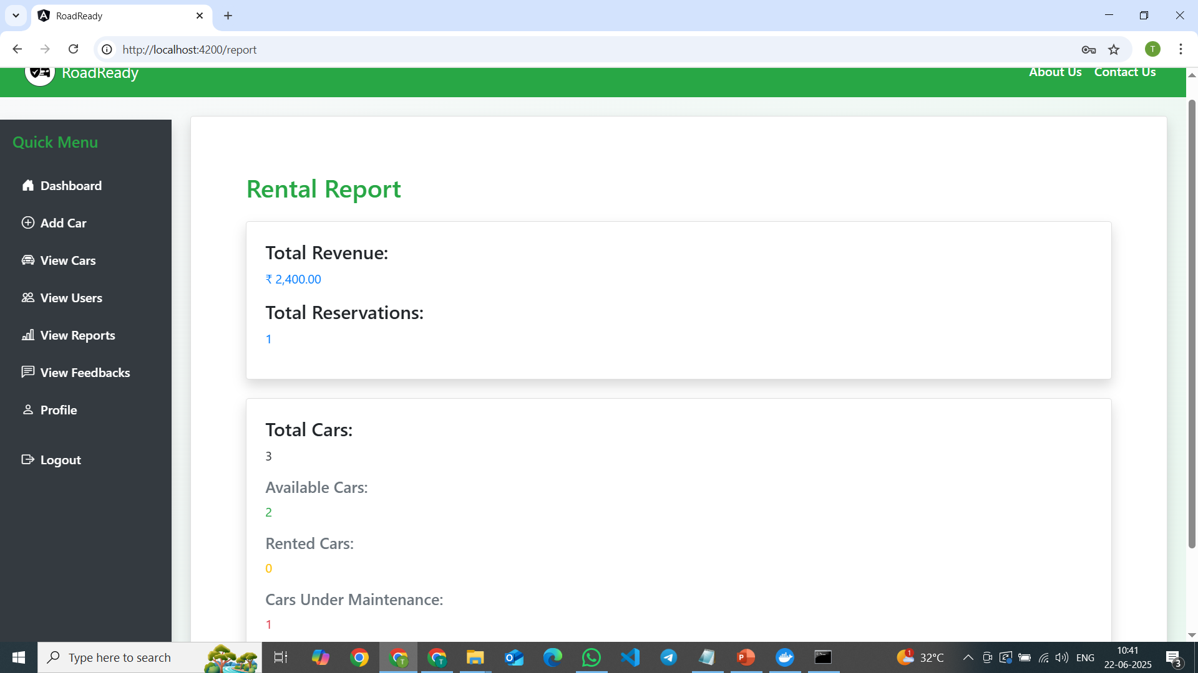
Rental report

Slide 14
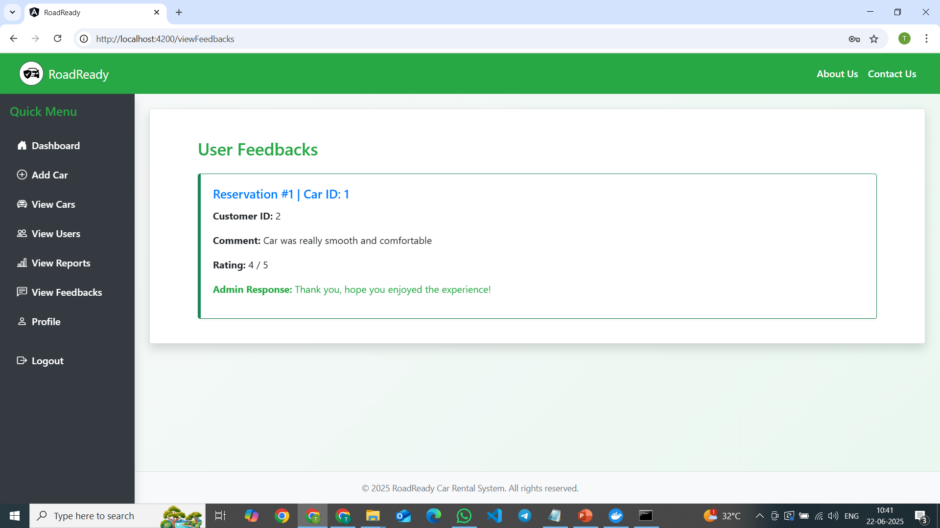
View users feedback

Slide 15
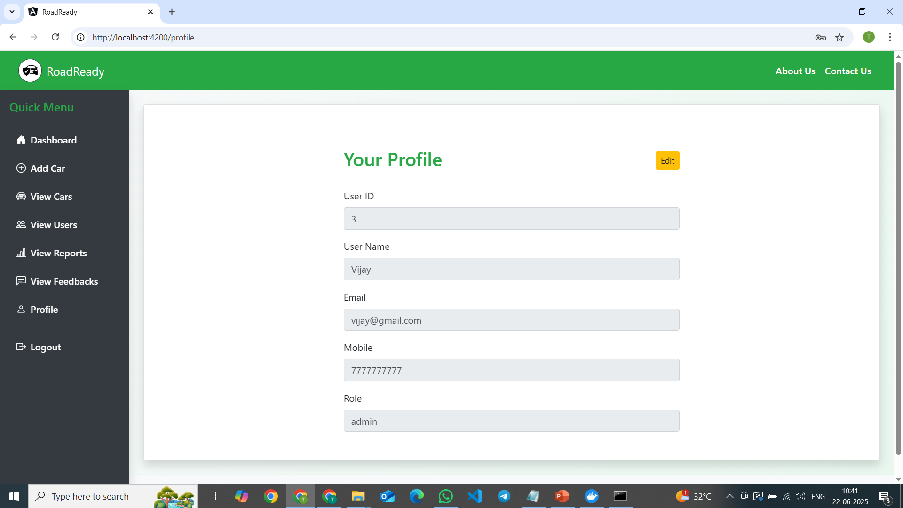
View user profile

Slide 16
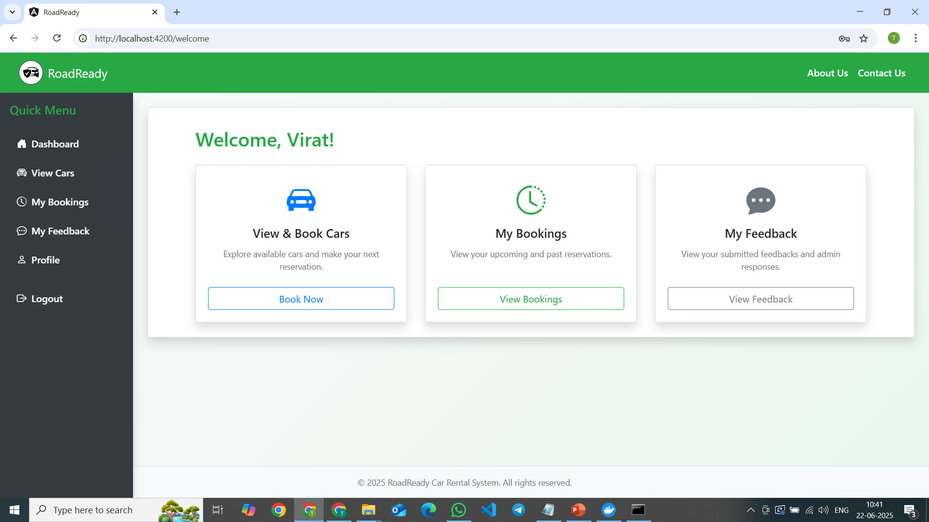
Customer Dashboard

Slide 17
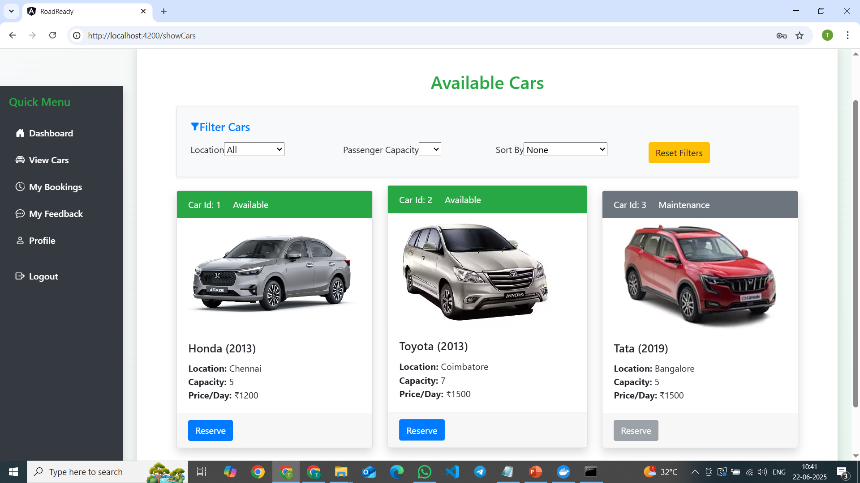
Customer – view cars

Slide 18
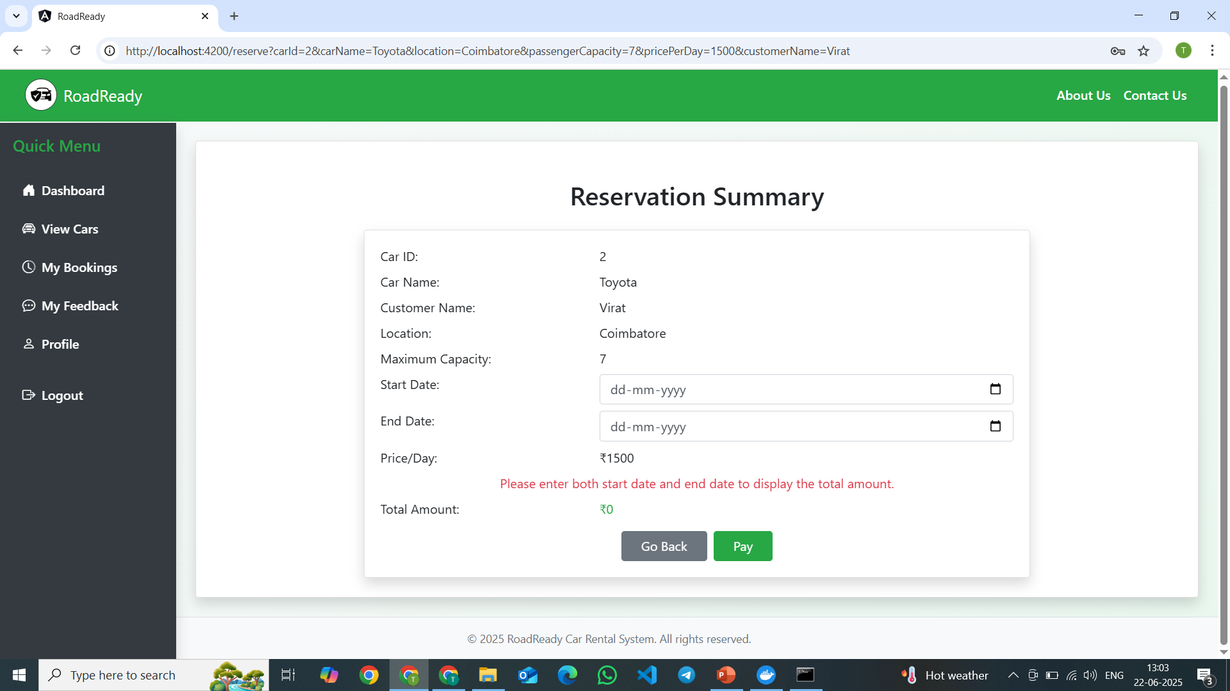
Reservation page

Slide 19
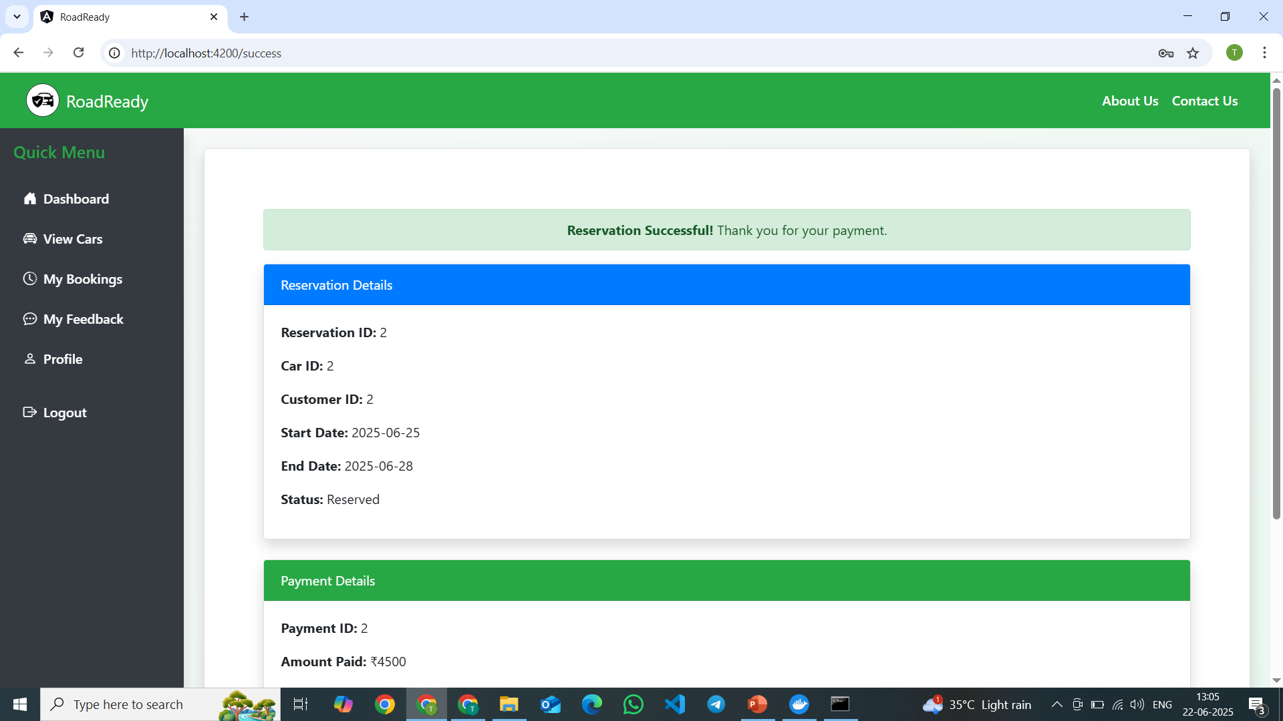
Reservation message

Slide 20
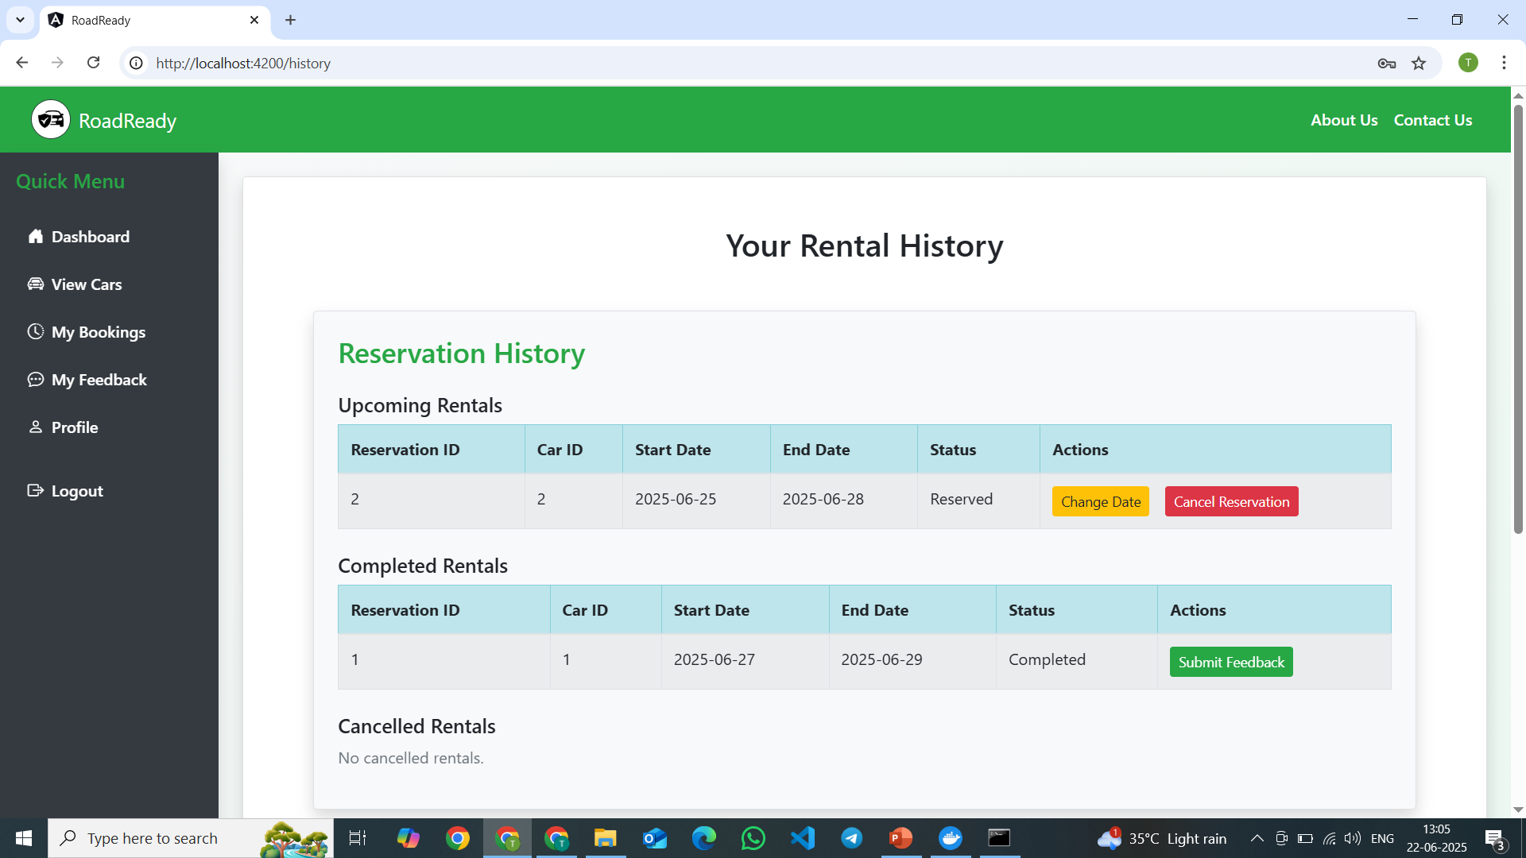
User bookings

Slide 21
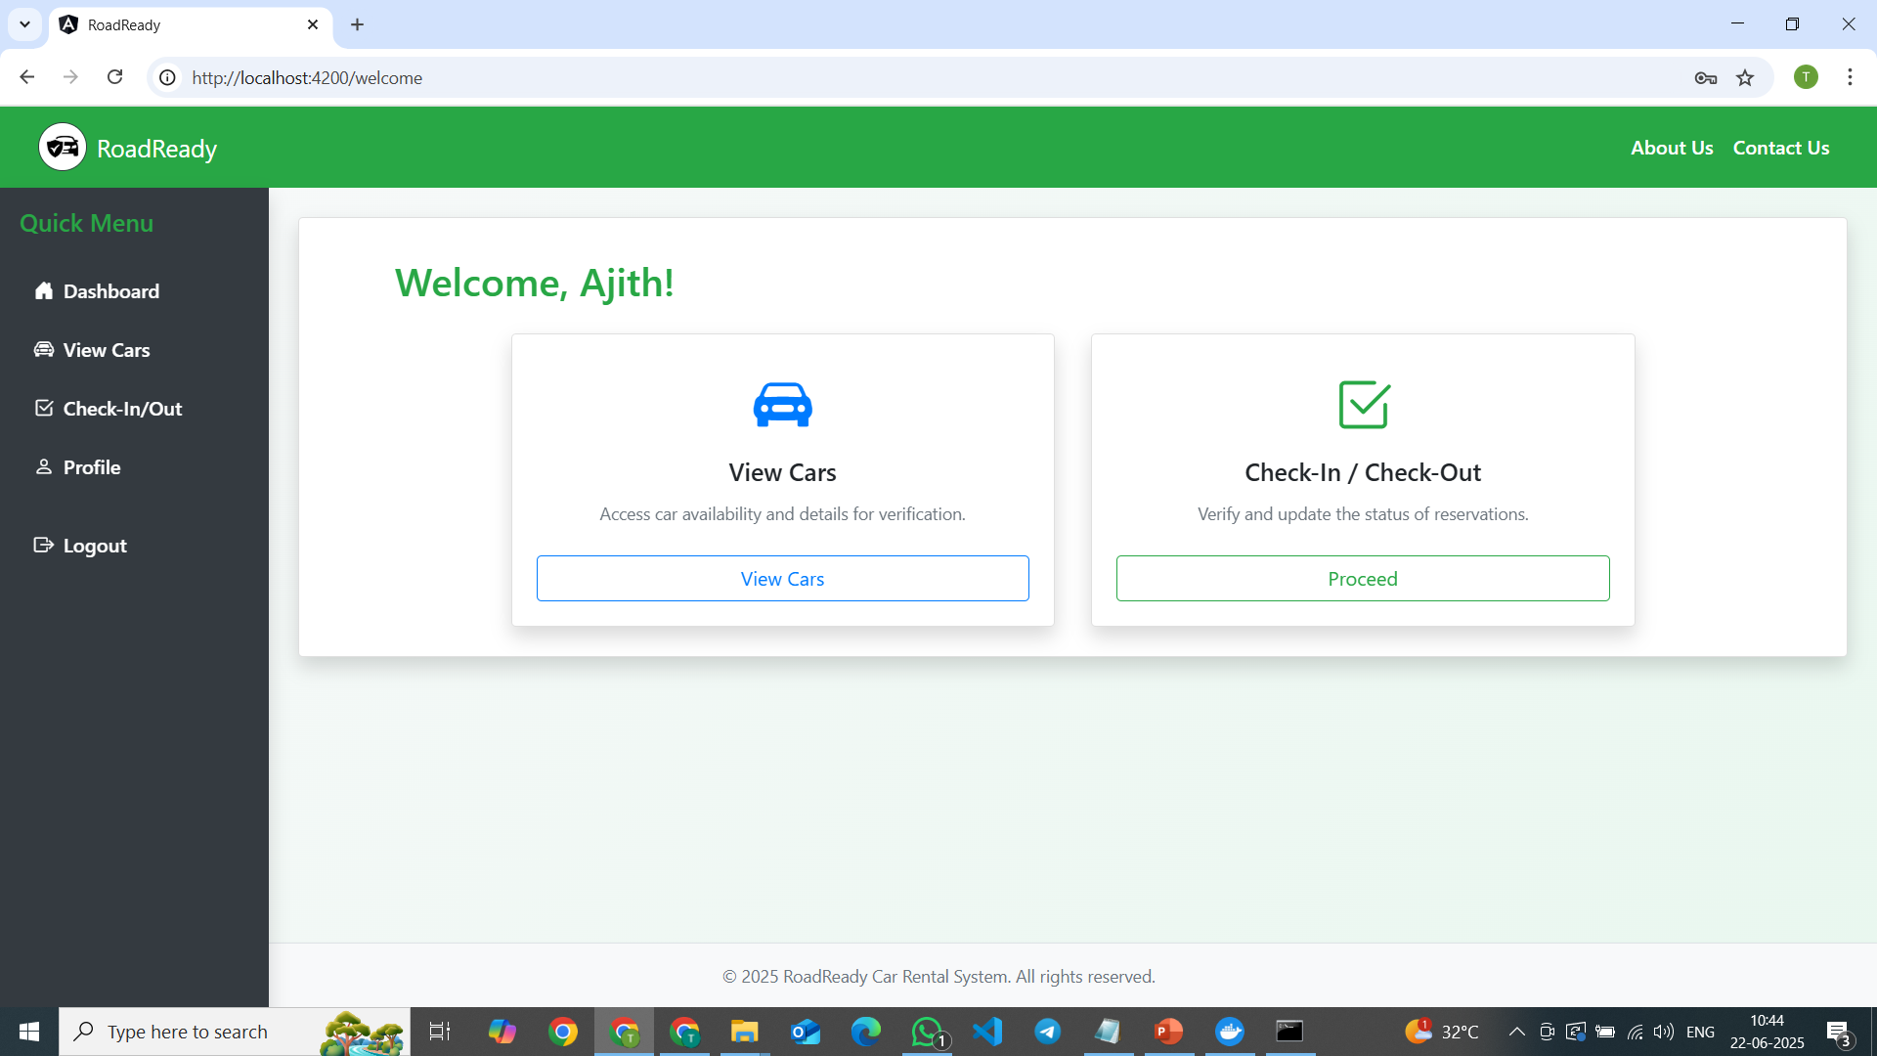
Agent dashboard

Slide 22
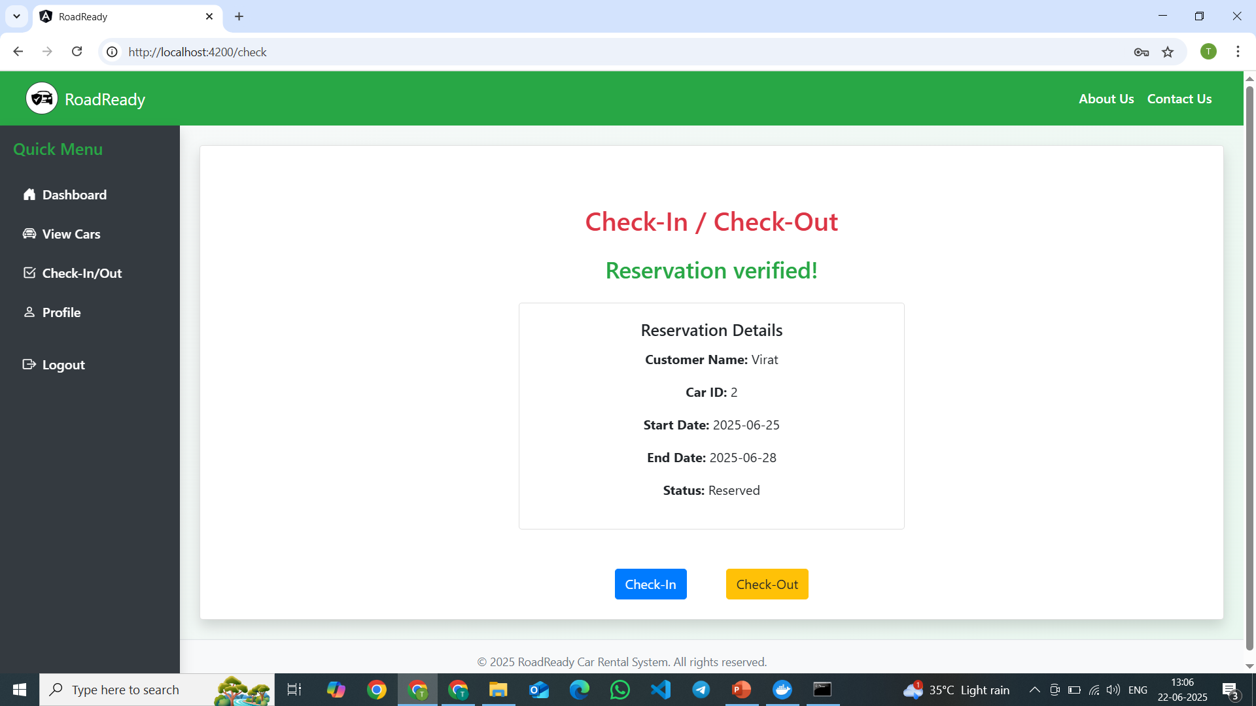
Agent – checkin/checkout

Slide 23
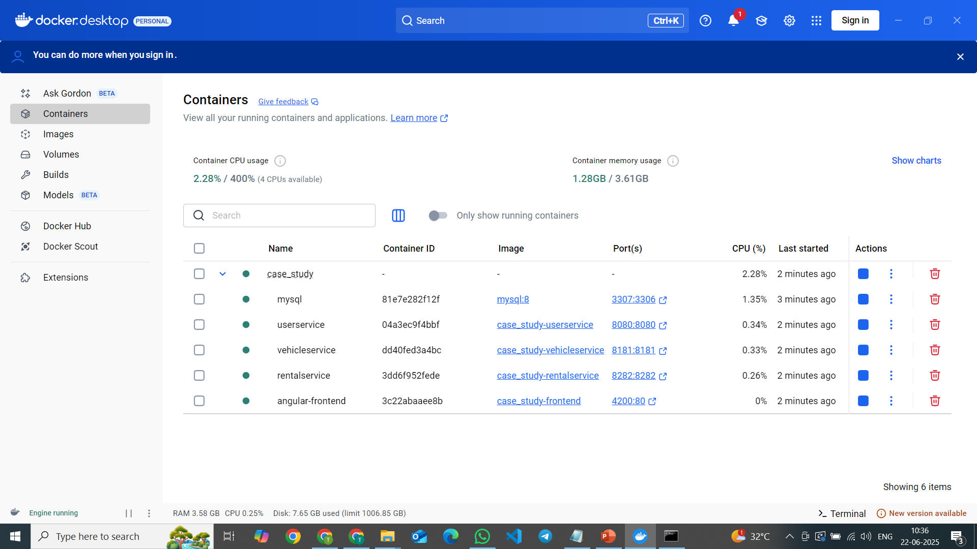
Running in docker container

Slide 24
Thank You!

